Slide 1
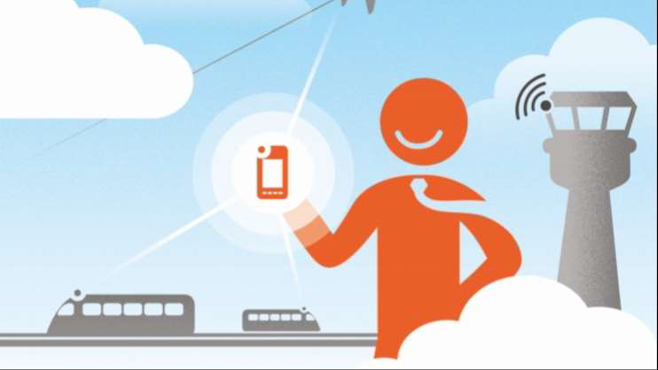
Public Transport Optimization
Build a secure foundation to leverage IOT for improved passenger experiences safety and efficiency

Slide 2
Project Definition:
The project involves integrating IoT sensors into public transportation vehicles to monitor ridership, track locations, and predict arrival times. The goal is to provide real-time transit information to the public through a public platform, enhancing the efficiency and quality of public transportation services. This project includes defining objectives, designing the IoT sensor system, developing the real-time transit information platform, and integrating them using IoT technology and Python.

Slide 3
What is IOT and how it’s involving in the transportation system:
IOT is the connection of your physical device to the internet. The internet of things (IOT) refers to the network of interconnected computer devices embedded in various objects, ranging from mobile devices and household appliances to vehicles and even structures.
The IoT has the potential to transform the transport industry by profoundly altering how transportation systems gather data and information by bringing together the major technical and business trends of mobility, automation and data analytics. IoT refers to the networking of physical objects through the use of embedded sensors, actuators, and other devices that can collect and transmit information about real-time activity in the network.

Slide 4
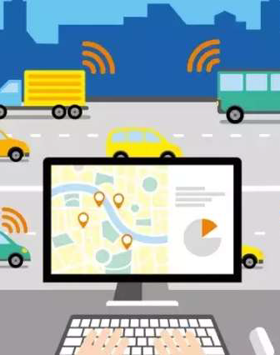
How the IOT is changing the transportation system: • Improve the traveler experience • Smart road and traffic management • Parking • Bridge sensors • Bicycle and pedestrian monitoring and safety • Micro-navigation in public transportation •Airport and air travels • IOT in travel innovations

Slide 5
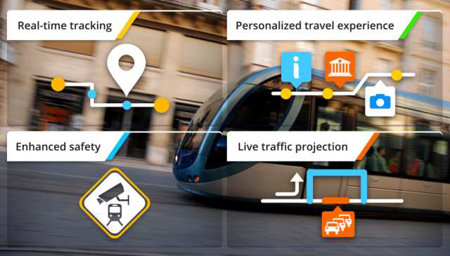
5 Top applications of IOT in Transportation :

Slide 6
Fleet management
Public transit management
Smart inventory management
Optimal asset utilization
Geo-fencing

Slide 7
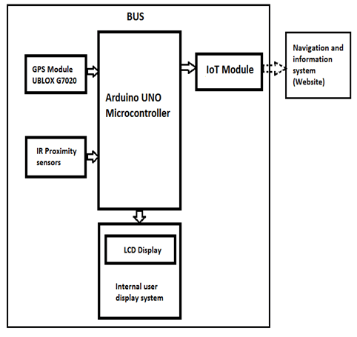
Block diagram

Slide 8
Sensors:
GPS Sensors: GPS sensors can track the location and speed of buses, trams, or other vehicles in the public transit fleet. This data helps in real-time vehicle tracking, route optimization, and accurate arrival time predictions for passengers.
Proximity Sensors: Proximity sensors can be used to detect when a vehicle is approaching a bus stop or transit station. This information can be used to trigger announcements or alerts for passengers and provide real-time updates.
Passenger Counting Sensors: These sensors, which can be based on infrared, ultrasonic, or other technologies, are installed in vehicles or at transportation hubs to count passengers boarding and alighting. This data helps optimize capacity planning and resource allocation.

Slide 9
1. Sensor Data Collection:
IoT sensors are strategically deployed throughout the transit system. These sensors can include GPS sensors on vehicles, passenger counters, environmental sensors, and more.
Sensors continuously collect data related to vehicle location, passenger counts, environmental conditions, and other relevant information.
2. Data Transmission Protocols:
IoT sensors use various communication protocols to transmit data to the platform. Common protocols include MQTT, HTTP/HTTPS, CoAP, and WebSocket.
3. Wireless Connectivity:
IoT sensors typically connect to the internet or a local network via wireless technologies, such as cellular networks (3G, 4G, 5G), Wi-Fi, or LoRaWAN, depending on the deployment location and infrastructure

Slide 10
CONCLUSION
public transport optimization is essential for addressing the mobility challenges faced by growing urban populations. By harnessing the power of data, technology, and community engagement, cities can create efficient and sustainable public transportation networks that benefit both passengers and the environment.

